Slide 1
CSC479
Data Mining
Classification Lecture 5
Basic Concepts
Bayesian Classification
Naïve Bayes Classification
(Ch # 8: Data Mining-Concepts and Techniques by Han and Kamber)

Slide 2
Bayesian Classification: Why?
A statistical classifier: performs probabilistic prediction, i.e., predicts class membership probabilities
Foundation: Based on Bayes’ Theorem.
Performance: A simple Bayesian classifier, naïve Bayesian classifier, has comparable performance with decision tree and selected neural network classifiers
Incremental: Each training example can incrementally increase/decrease the probability that a hypothesis is correct — prior knowledge can be combined with observed data

Slide 3
Bayes’ Theorem: Basics
Total probability Theorem:
Bayes’ Theorem:
Let X be a data sample (“evidence”): class label is unknown
Let H be a hypothesis that X belongs to class C
Classification is to determine P(H|X), (i.e., posteriori probability): the probability that the hypothesis holds given the observed data sample X
P(H) (prior probability): the initial probability
E.g., X will buy computer, regardless of age, income, …
P(X): probability that sample data is observed
P(X|H) (likelihood): the probability of observing the sample X, given that the hypothesis holds
E.g., Given that X will buy computer, the prob. that X is 31..40, medium income

Slide 4
Prediction Based on Bayes’ Theorem
Given training data X, posteriori probability of a hypothesis H, P(H|X), follows the Bayes’ theorem
Informally, this can be viewed as
posteriori = likelihood x prior/evidence
Predicts X belongs to C_{i} iff the probability P(C_{i}|X) is the highest among all the P(C_{k}|X) for all the k classes
Practical difficulty: It requires initial knowledge of many probabilities, involving significant computational cost

Slide 5
Classification Is to Derive the Maximum Posteriori
Let D be a training set of tuples and their associated class labels, and each tuple is represented by an n-D attribute vector X = (x₁, x₂, …, x_{n})
Suppose there are m classes C₁, C₂, …, C_{m}.
Classification is to derive the maximum posteriori, i.e., the maximal P(C_{i}|X)
This can be derived from Bayes’ theorem
Since P(X) is constant for all classes, only
needs to be maximized

Slide 6
Naïve Bayes Classifier
A simplified assumption: attributes are conditionally independent (i.e., no dependence relation between attributes):
This greatly reduces the computation cost: Only counts the class distribution
If A_{k} is categorical, P(x_{k}|C_{i}) is the # of tuples in C_{i} having value x_{k} for A_{k} divided by |C_{i, D}| (# of tuples of C_{i} in D)
If A_{k} is continous-valued, P(x_{k}|C_{i}) is usually computed based on Gaussian distribution with a mean μ and standard deviation σ
and P(x_{k}|C_{i}) is

Slide 7
Naïve Bayes Classifier: Training Dataset
Class:
C1:buys_computer = ‘yes’
C2:buys_computer = ‘no’
Data to be classified:
X = (age <=30,
Income = medium,
Student = yes
Credit_rating = Fair)

Slide 8
Naïve Bayes Classifier: An Example
P(C_{i}): P(buys_computer = “yes”) = 9/14 = 0.643
P(buys_computer = “no”) = 5/14= 0.357
Compute P(X|C_{i}) for each class
P(age = “<=30” | buys_computer = “yes”) = 2/9 = 0.222
P(age = “<= 30” | buys_computer = “no”) = 3/5 = 0.6
P(income = “medium” | buys_computer = “yes”) = 4/9 = 0.444
P(income = “medium” | buys_computer = “no”) = 2/5 = 0.4
P(student = “yes” | buys_computer = “yes) = 6/9 = 0.667
P(student = “yes” | buys_computer = “no”) = 1/5 = 0.2
P(credit_rating = “fair” | buys_computer = “yes”) = 6/9 = 0.667
P(credit_rating = “fair” | buys_computer = “no”) = 2/5 = 0.4
X = (age <= 30 , income = medium, student = yes, credit_rating = fair)
P(X|C_{i}) : P(X|buys_computer = “yes”) = 0.222 x 0.444 x 0.667 x 0.667 = 0.044
P(X|buys_computer = “no”) = 0.6 x 0.4 x 0.2 x 0.4 = 0.019
P(X|C_{i})*P(C_{i}) : P(X|buys_computer = “yes”) * P(buys_computer = “yes”) = 0.028
P(X|buys_computer = “no”) * P(buys_computer = “no”) = 0.007
Therefore, X belongs to class (“buys_computer = yes”)

Slide 9
Avoiding the Zero-Probability Problem
Naïve Bayesian prediction requires each conditional prob. be non-zero. Otherwise, the predicted prob. will be zero
Ex. Suppose a dataset with 1000 tuples, income=low (0), income= medium (990), and income = high (10)
Use Laplacian correction (or Laplacian estimator)
Adding 1 to each case
Prob(income = low) = 1/1003
Prob(income = medium) = 991/1003
Prob(income = high) = 11/1003
The “corrected” prob. estimates are close to their “uncorrected” counterparts

Slide 10
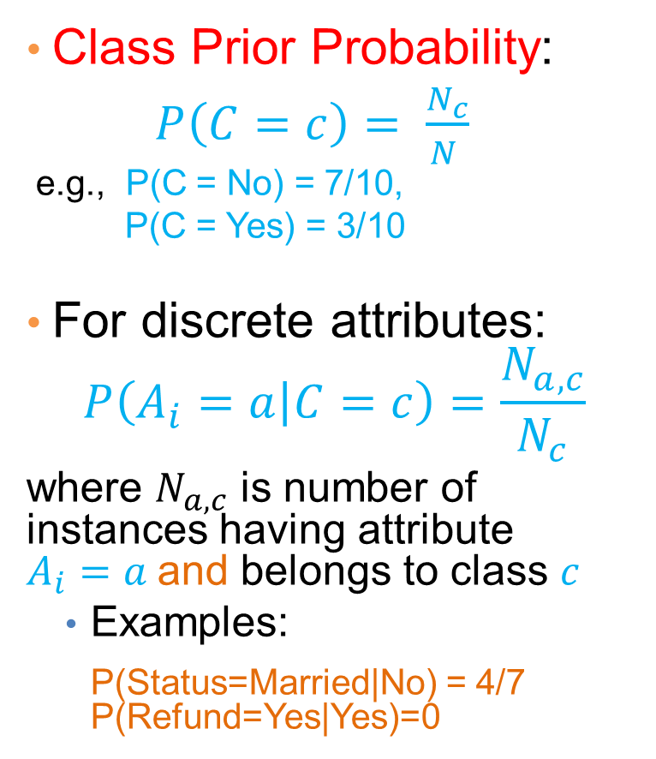
How to Estimate Probabilities from Data?

Slide 11
How to Estimate Probabilities from Data?
Normal distribution:
One for each (a_{i},c_{i}) pair
For (Income, Class=No):
If Class=No
sample mean = 110
sample variance = 2975

Slide 12
Example of Naïve Bayes Classifier
Creating a Naïve Bayes Classifier, essentially means to compute counts:
Total number of records: N = 10
Class No:
Number of records: 7
Attribute Refund:
Yes: 3
No: 4
Attribute Marital Status:
Single: 2
Divorced: 1
Married: 4
Attribute Income:
mean: 110
variance: 2975
Class Yes:
Number of records: 3
Attribute Refund:
Yes: 0
No: 3
Attribute Marital Status:
Single: 2
Divorced: 1
Married: 0
Attribute Income:
mean: 90
variance: 25

Slide 13
Example of Naïve Bayes Classifier
Given a Test Record:
P(X|Class=No) = P(Refund=No|Class=No) × P(Married| Class=No) × P(Income=120K| Class=No) = 4/7 × 4/7 × 0.0072 = 0.0024
P(X|Class=Yes) = P(Refund=No| Class=Yes) × P(Married| Class=Yes) × P(Income=120K| Class=Yes) = 1 × 0 × 1.2 × 10⁻⁹ = 0
P(No) = 0.3, P(Yes) = 0.7
Since P(X|No)P(No) > P(X|Yes)P(Yes)
Therefore P(No|X) > P(Yes|X) => Class = No

Slide 14
Example of Naïve Bayes Classifier
Given a Test Record:
With Laplace Smoothing
P(X|Class=No) = P(Refund=No|Class=No) × P(Married| Class=No) × P(Income=120K| Class=No) = 5/9 × 5/10 × 0.0072
P(X|Class=Yes) = P(Refund=No| Class=Yes) × P(Married| Class=Yes) × P(Income=120K| Class=Yes) = 4/5 × 1/6 × 1.2 × 10⁻⁹
P(No) = 0.7, P(Yes) = 0.3
Since P(X|No)P(No) > P(X|Yes)P(Yes)
Therefore P(No|X) > P(Yes|X) => Class = No

Slide 15
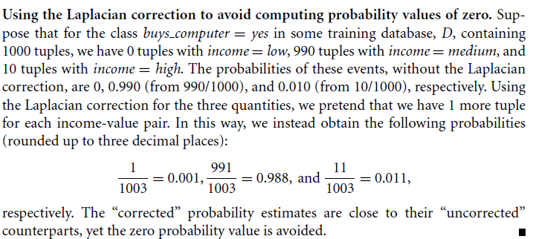
Example of Laplacian correction
In order to avoid probability values of zero we can add one value to each category of the attribute with zero count category.
Examples 8.5:

Slide 16
Naïve Bayesian classification – Example
Estimating P(x_{i}|C)
P(p) = 9/14
P(n) = 5/14

Slide 17
Naïve Bayesian classification – Example
Classifying X:
an unseen sample X = <rain, hot, high, false>
P(X|p)·P(p) = P(rain|p)·P(hot|p)·P(high|p)·P(false|p)·P(p) = 3/9·2/9·3/9·6/9·9/14 = 0.010582
P(X|n)·P(n) = P(rain|n)·P(hot|n)·P(high|n)·P(false|n)·P(n) = 2/5·2/5·4/5·2/5·5/14 = 0.018286
Sample X is classified in class n (don’t play)

Slide 18
Naïve Bayes Classifier: Comments
Advantages
Easy to implement
Good results obtained in most of the cases
Disadvantages
Assumption: class conditional independence, therefore loss of accuracy
Practically, dependencies exist among variables
E.g., hospitals: patients: Profile: age, family history, etc.
Symptoms: fever, cough etc., Disease: lung cancer, diabetes, etc.
Dependencies among these cannot be modeled by Naïve Bayes Classifier

